Slide 1
Supervised Machine Learning
Logistic Regression

Slide 2
Logistic Regression and classification model evaluation
Logistic Regression:
Introduction to Logistic Regression.
Math behind Logistic Regression.
Advantages of Logistic Regression.
Model Evaluation:
Introduction to different metrics used for model evaluation in classification problems.
Confusion matrix and related metrics like F1 Score.
Gini Coefficient and ROC and relation between them.

Slide 3
Introduction to Logistic Regression
Logistic Regression is an example of a classification algorithm which is used to find a relationship between features and probability of a particular outcome. The term “Logistic” is taken from the Logit function that is used in this method of classification.
In Logistic Regression, the dependent variable is binary rather than continuous and it can also be applied to ordered categories (ordinal data).
In regression analysis, logistic regression or logit regression is estimating the parameters of a logistic model.

Slide 4
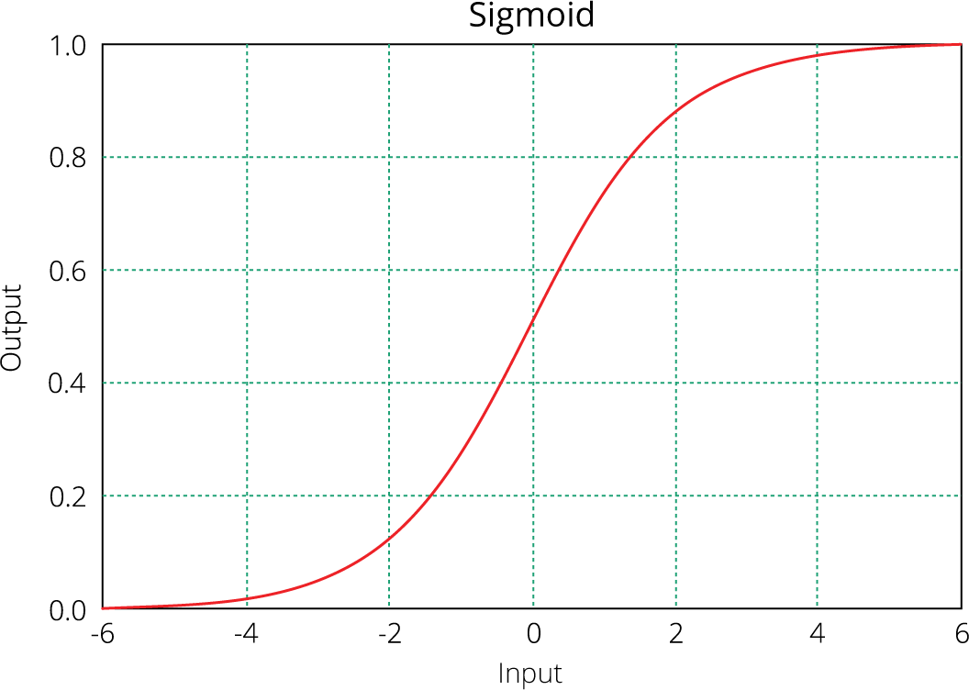
Logistic Regression
The name ‘Logistic Regression’, comes from it’s underlying technique which is quite the
same as Linear Regression.
Sigmoid function which limits its range of probabilities between 0 and 1.
Here, y is dependent variable and X1, X2 … and Xn are explanatory variables.
The sigmoid function can be written as:
The equation of Logistic Regression

Slide 5
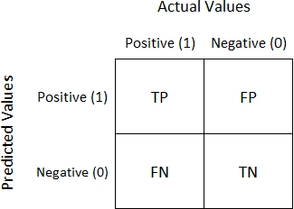
Logistic Regression Advantages
It is a model that gives probabilities.
It can be easily scaled to multiple classes.
It is very quick to train and very fast at classifying unknown records.
Metrics: Confusion Matrix
Well, it is a performance measurement for machine learning classification problem where output can be two or more classes. It is a table with 4 different combinations of predicted and actual values.
TP: True Positive
TN: True Negative
FP: False Positive
FN: False Negative

Slide 6
Logistic Regression Advantages
Confusion Matrix Contd
 |  | Actual
 |  | 1 | 0
Predicted | 1 | TP | FP
 | 0 | FN | TN

Slide 7
Logistic Regression
F1 Score
A single metric is not sufficient for the evaluation of classification models. We have seen that we need to use recall and precision together along with accuracy to evaluate our model.
Let us consider another metric that puts together the recall and precision metrics. We call it
F1 Score which is the harmonic mean of the two metrics – Precision and Recall.
F1 Score = 2(precision*recall)/(precision + recall)
The F1 score can also be used to evaluate the model.

Slide 8
Logistic Regression
ROC-AUC
Roc is a curve which allows us to compare models.
It is plot between TPR(true positive rates) and FPR(false positive rates).
The area under the ROC curve (AUC) is a measure of the how good a model is.
The value for AUC lies between 0 and 1. Larger AUC implies better model.
Image courtesy: Photoshopped collection

Slide 9
THANK YOU
Happy

